Slide 1
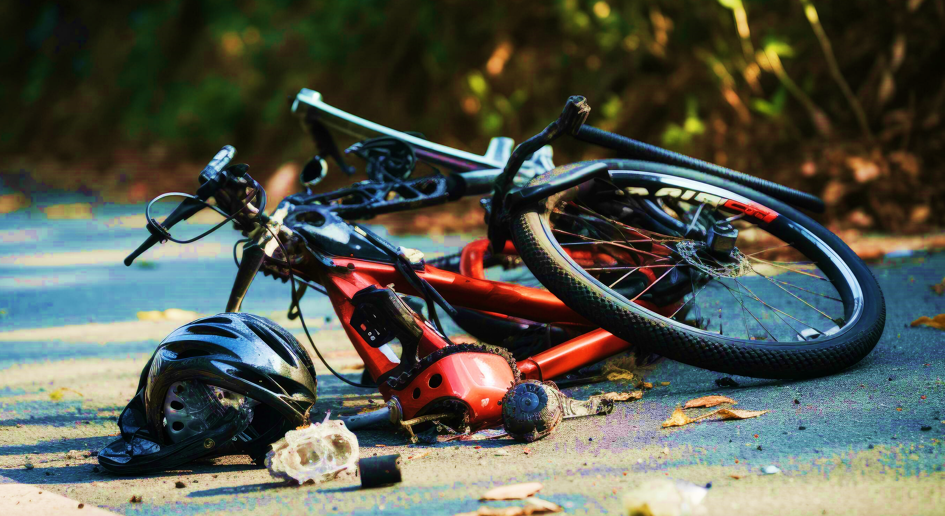
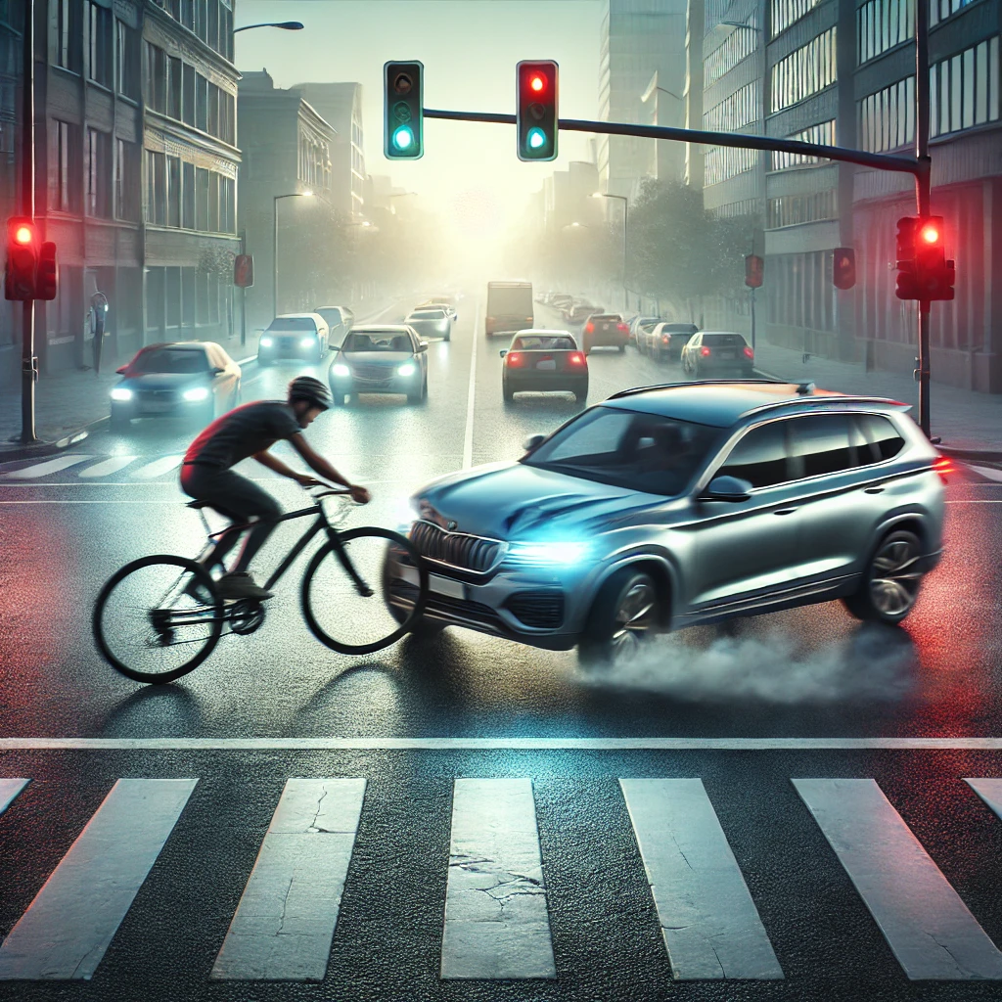
Analyzing Factors Influencing Non-Motorist Crash Occurrence and Severity in Oklahoma
Team #20
Tahsin Tabassum
Hananeh Omidi
Aqsa Rehman
Abrar Mohamed
Notes:
HANA

Slide 2
Introduction
Context
Non-motorists — such as pedestrians and cyclists — are among the most vulnerable road users. Crashes involving non-motorists often result in severe injuries or fatalities, making it critical to understand and predict crash severity.
The Challange
Can we accurately predict the severity of a crash based on conditions such as weather, road type, time of day, and environmental factors?
The aim of this project is to develop predictive models and use tools from DSA 5103 to predict crash severity and identify the most significant risk factors for non-motorists.
Notes:
HANA

Slide 3
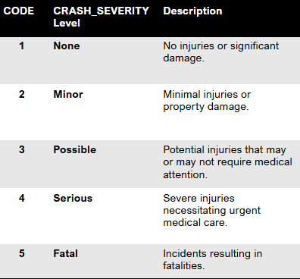
About the Data
Data Source: Oklahoma Highway Safety Office website.
The Target variable is crash severity, and it has 5 levels: none, minor, possible, serious, and fatal.
Key Variables
Weather Conditions (e.g., clear, rainy, foggy)
Time of Day (e.g., daytime, nighttime)
Road Type (e.g., highway, urban street)
Environmental Conditions (e.g., lighting, road surface)
Data size
74122 observation , 67 variables (numerical and categorical with multiple levels)
Notes:
HANA

Slide 4
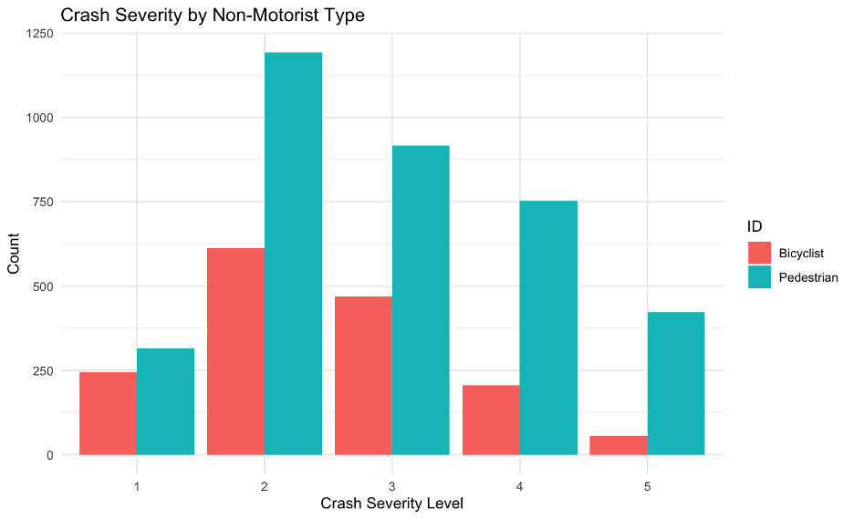
Exploratory Data Analysis (EDA)
Notes:
MORE PADESTRIAN
MOSTLY ADULTS
IMBALANCE DISTRIBUTION, MINOR AND POSSIBLE HAVE MORE CRASHES

Slide 5
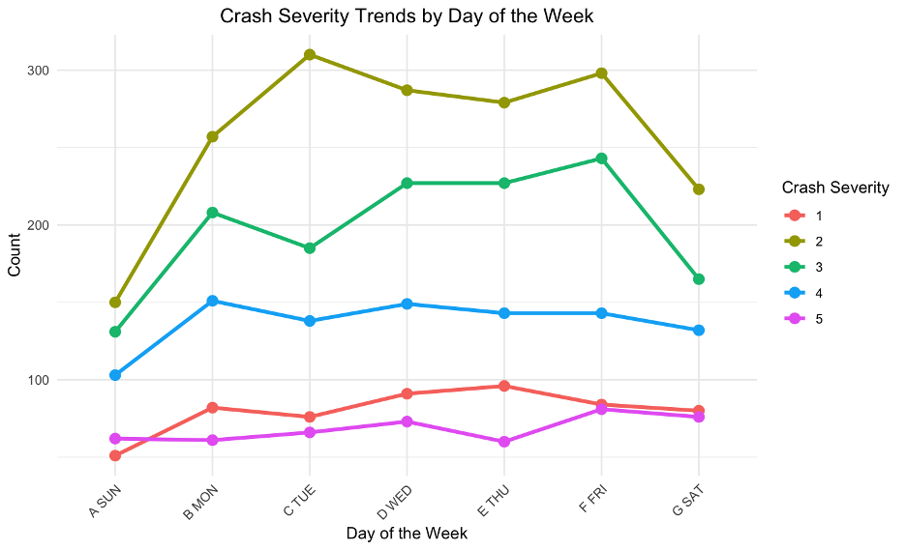
Exploratory Data Analysis (EDA)
Notes:
MOST CRASHES DURING CLEAR-DAY LIGHT
A LOT ON CLOUDY AND RAINY UNDER DARK LIGHTING
SERIOUS AND FATAL DARK LIGHT-CLOUDY.
END OF THE YEAR, HOLIDAY,OUTSIDE DRIVE,
WEEKEND LESS CRASH, WEEKDAYS MORE

Slide 6
Data Preparation
Missing data
Imputed missing values
Data Cleaning
Removed irrelevant columns
Feature Engineering
Time-based features
Lumped categories
Encoding Categorical Variables
Feature Scaling
Standardized numerical features
Class Imbalance
Applied SMOTE
Applied one-hot encoding
Split data into training and testing sets, 80% for training, 20% for testing
28 variables modeled
Notes:
67 TO 28
One-Hot Encoding Converts categorical variables into binary indicators
SMOTE (Synthetic Minority Over-sampling Technique)

Slide 7
Modeling Approach
Type | Method | Detailed Classification
Unsupervised | K-Means Clustering | Clustering
Supervised | Multinomial Logistic Regression (MLR) | Statistical Model
 | Support Vector Machine (SVM) | Classification and Regression
 | Random Forest (RF) | Ensemble Learning
 | Artificial Neural Networks (ANN) | Deep Learning
 | Conditional Forest (CF) | Ensemble Learning (Tree-Based)
 | Extreme Gradient Boosting (XGBoost) | Gradient Boosting Machine
 | Stacking | Ensemble Learning (Meta-Modeling)
10-fold cross-validation was utilized to ensure the robustness and reliability of our model performance
Notes:
AQSA

Slide 8
Clustering
Approach: K-means clustering applied on PCA-reduced data, visualized using t-SNE, grouped non-motorist crashes into five distinct clusters based on severity, environment, and temporal factors.
Silhouette Score (PAM): 0.561872
Cluster 1: Daytime crashes in clear weather, minor injuries.
Cluster 2: Urban intersection crashes, high occupancy, dense traffic risks.
Cluster 3: Night crashes, poor lighting, severe/fatal outcomes.
Cluster 4: Daytime crashes in clear weather, minor injuries.
Cluster 5: Hit-and-run crashes, varied severity, unpredictable risks.
Notes:
AQSA

Slide 9
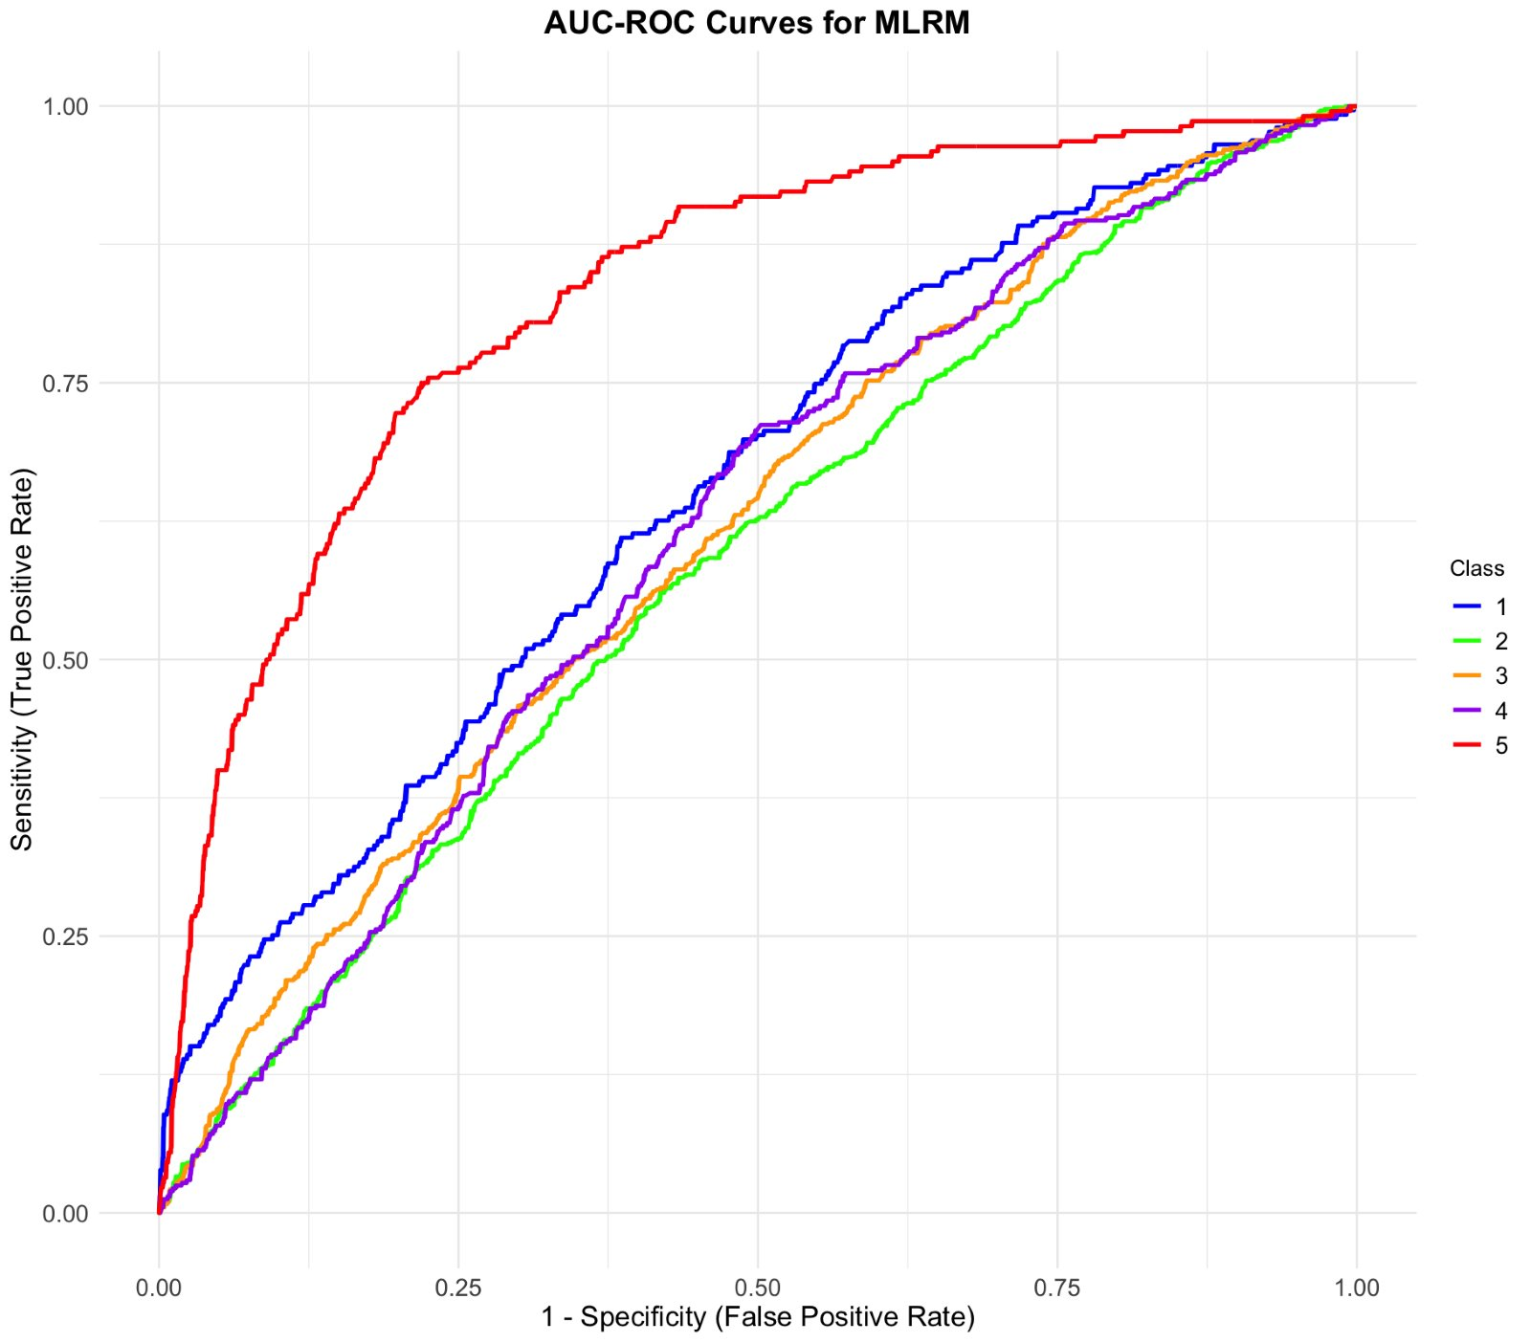
Statistical Model
Multinomial Logistic Regression
Metric | None | Possible | Minor | Serious | Fatal
Sensitivity | 0.11969 | 0.74930 | 0.17570 | 0.09606 | 0.40455
Specificity | 0.98830 | 0.33730 | 0.90093 | 0.93344 | 0.94162
Pos Pred Value | 0.57407 | 0.35590 | 0.40075 | 0.24375 | 0.43204
Neg Pred Value | 0.89493 | 0.73360 | 0.74348 | 0.82219 | 0.93508
Prevalence | 0.11646 | 0.32820 | 0.27383 | 0.18255 | 0.09892
Detection Rate | 0.01394 | 0.24600 | 0.04811 | 0.01754 | 0.04002
Detection Prevalence | 0.02428 | 0.69110 | 0.12005 | 0.07194 | 0.09263
Metric | None | Possible | Minor | Serious | Fatal | Overall
F1-Score | 0.4578 | 0.7586 | 0.8089 | 0.8618 | 0.9480 | 0.77 (Macro Avg)
AUC | 0.6531 | 0.5861 | 0.6130 | 0.6113 | 0.8283 | 0.66 (Macro Avg)
G-Mean | 0.7528 | 0.5243 | 0.3348 | 0.3235 | 0.2967 | 0.446 (Avg)
Notes:
AQSA

Slide 10
ML Models
Suport Vector Machine
Artificial Neural Network
Class | Precision | Recall | F1_Score | Specificity | G_Mean
None | 0.6206897 | 0.1104294 | 0.1875000 | 0.9916477 | 0.3309186
Possible | 0.3586498 | 0.2130326 | 0.2672956 | 0.8593895 | 0.4278761
Minor | 0.3903743 | 0.5770751 | 0.4657097 | 0.5318275 | 0.5539895
Serious | 0.2727273 | 0.0219780 | 0.0406780 | 0.9867440 | 0.1472640
Fatal | 0.2297297 | 0.7338129 | 0.3499142 | 0.7449664 | 0.7393687
AVG | 0.3744342 | 0.3312656 | 0.2622195 | 0.8229150 | 0.4398834
Class | Precision | Recall | F1_Score | Specificity | G_Mean
None | 0.4594595 | 0.1042945 | 0.1700000 | 0.9848140 | 0.3204850
Possible | 0.3603604 | 0.1002506 | 0.1568628 | 0.9343201 | 0.3060493
Minor | 0.3747045 | 0.6264822 | 0.4689349 | 0.4568789 | 0.5350014
Serious | 1.0000000 | 0.0073260 | 0.0145455 | 1.0000000 | 0.0855921
Fatal | 0.2004132 | 0.6978417 | 0.3113965 | 0.7114094 | 0.7045929
AVG | 0.4789875 | 0.3072390 | 0.2243479 | 0.8174845 | 0.3903441
Random Forest
XG Boost
Class | Precision | Recall | F1_Score | Specificity | G_Mean
None | 0.4600000 | 0.1411043 | 0.2159624 | 0.9794989 | 0.3717681
Possible | 0.3668478 | 0.3383459 | 0.3520209 | 0.7844588 | 0.5151877
Minor | 0.4228571 | 0.5849802 | 0.4908789 | 0.5852156 | 0.5850979
Serious | 0.4032258 | 0.1831502 | 0.2518892 | 0.9386910 | 0.4146341
Fatal | 0.3487395 | 0.5971223 | 0.4403183 | 0.8844146 | 0.7267074
AVG | 0.40033404 | 0.36894058 | 0.35021394 | 0.83445578 | 0.52267904
Class | Precision | Recall | F1_Score | Specificity | G_Mean
None | 0.5227273 | 0.1411043 | 0.2222222 | 0.9840547 | 0.3726316
Possible | 0.3738872 | 0.3157895 | 0.3423913 | 0.8048104 | 0.5041336
Minor | 0.3975000 | 0.6284585 | 0.4869832 | 0.5051335 | 0.5634318
Serious | 0.3120567 | 0.1611722 | 0.2125604 | 0.9196355 | 0.3849930
Fatal | 0.4240506 | 0.4820144 | 0.4511785 | 0.9321402 | 0.6703022
AVG | 0.40604436 | 0.34570778 | 0.34306712 | 0.82915486 | 0.49909844
Notes:
ABRA

Slide 11
STACKED PERFORMANCE MEASURE
Stacking
Class | Precision | Recall | F1_Score | Specificity | G_Mean
None | 0.8695652 | 0.1226994 | 0.2150538 | 0.9977221 | 0.3498855
Possible | 0.4420601 | 0.5162907 | 0.4763006 | 0.7594820 | 0.6261897
Minor | 0.4575342 | 0.6600791 | 0.5404531 | 0.5934292 | 0.6258675
Serious | 0.4500000 | 0.2307692 | 0.3050847 | 0.9362055 | 0.4648090
Fatal | 0.5206612 | 0.4532374 | 0.4846154 | 0.9567487 | 0.6585091
AVG | 0.54796414 | 0.4532374 | 0.4846154 | 0.89636552 | 0.54505216
Notes:
ABRAR

Slide 12
Graphs of RF feature rank and ROC curves
RF Feature Importance Ranking
Notes:
ABRAR

Slide 13
CONCLUSION, Insights and RECOMMENDATIONS
Insights
Key Risk Factors
Time of Day and Lighting
Nighttime conditions significantly increase crash severity
Weather Conditions
Clear weather is associated with less severe outcomes, while adverse weather can increase crash severity.
Road Type and Urban Density
Crashes at urban intersections are more frequent
Recommendations
Enhance Street Lighting
Install or upgrade streetlights in high-risk areas, especially intersections and crosswalks
Weather-Responsive Traffic Systems
Implement adaptive traffic control systems that adjust signal timings during adverse weather
Intersection Safety Measures
Implement traffic-calming measures and dedicated non-motorist pathways at busy urban intersections
Install smart signals with longer pedestrian crossing times and sensors that detect non-motorists to improve safety
Notes:
Abrar

Slide 14
THANK YOU, ANY QUESTION?

